Slide 1
Chapter 1
Database Systems

Slide 2
What is Database?
Database refers to an organized collection of electronic records that could be processed to produce useful information.

Slide 3
Why Databases?
Databases make data persistent and shareable in a secure way
  Specialized structures that allow computer-based systems to store, manage, and retrieve data very quickly

Slide 4
Types of Databases
Single-user database: supports one user at a time
  Desktop database: single-user database on a personal computer
Multiuser database: supports multiple users at the same time
  Workgroup databases: supports a small number of users or a specific department
  Enterprise database: supports many users across many departments

Slide 5
Types of Databases
Databases can be classified to reflect how they will be used.
Operational Database -OLTP (online transaction processing) database – support a company’s day-to-day operations.
Data warehouse-OLAP (online analytical processing) database-
stores historical data, helps with enterprise wide planning, problem solving, and decision making.

Slide 6
DATA & INFORMATION
Data - Raw facts that describe the characteristics of an event or object
Information - Data converted into a meaningful and useful context

Slide 7
Example
Customer | Product | Qty Sold | Proﬁt | Date
Walmart | Doritos | 41 | $246 | 2/3/2017
Walmart | Ruffles | 90 | $450 | 3/5/2017
Safeway | Ruffles | 27 | $135 | 5/6/2017
Walmart | Ruffles | 67 | $335 | 7/8/2017
7-Eleven | Pringles | 79 | $474 | 2/7/2018
Kroger | Ruffles | 52 | $260 | 5/7/2018
Walmart | Ruffles | 39 | $195 | 5/10/2018
$474+$260+$195 = $929

Slide 8
Why Database Design Is Important
Focuses on design of database structure that will be used to store and manage end-user data
  Well-designed database facilitates data management and generates accurate and valuable information
  Poorly designed database causes difficult-to-trace errors that may lead to poor decision making

Slide 9
Requirements of a good database design
1. Preserve relationships between data.
2. Store all data.
3. Avoid redundant storage of data.

Slide 10
Storing Data Efficiently (University Database Example)
StudentID | StudentFirstName | Major | CourseID | CourseName | Grade
A1 | Amy | Finance | 101 | Finance Fundamentals | A
A2 | Casandra | CIS | 102 | Business Info Systems | B+
A3 | Joe | Accounting | 103 | Marketing Management | A-
A1 | Amy | Finance | 103 | Marketing Management | B-
A2 | Casandra | CIS | 101 | Finance Fundamentals | A
A3 | Joe | Accounting | 102 | Business Info Systems | B
A4 | Tim | Management
A5 | Shawn | Marketing
A6 | Chen | CIS
A7 | James | Accounting
 |  |  | 104 | Financial Accounting
 |  |  | 105 | Managing Organizations

Slide 11
Storing Data Efficiently (University Database Example)
Figure 1. Students Table
Figure 2. Courses Table
StudentID | StudentFirstName | Major
A1 | Amy | Finance
A2 | Casandra | CIS
A3 | Joe | Accounting
A4 | Tim | Management
A5 | Shawn | Marketing
A6 | Chen | CIS
A7 | James | Accounting
CourseID | CourseName
101 | Finance Fundamentals
102 | Business Info Systems
103 | Marketing Management
104 | Financial Accounting
105 | Managing Organizations
Figure 3. Grades Table
StudentID | CourseID | Grade
A1 | 101 | A
A2 | 102 | B+
A3 | 103 | A-
A1 | 103 | B-
A2 | 101 | A
A3 | 102 | B

Slide 12
Data Redundancy
Possible results of uncontrolled data redundancy
  Poor data security
  Data inconsistency
  Data-entry errors
  Data integrity problems

Slide 13
Data Anomalies
Develop when not all of the required changes in the redundant data are made successfully
  Update anomalies
  Insertion anomalies
  Deletion anomalies

Slide 14
What is DBMS?
Database Management System (DBMS) refers to the technology solution used to optimize and manage the storage and retrieval of data from databases.
Examples: MySQL, Oracle, PostgreSQL, Microsoft Access, SQL Server

Slide 15
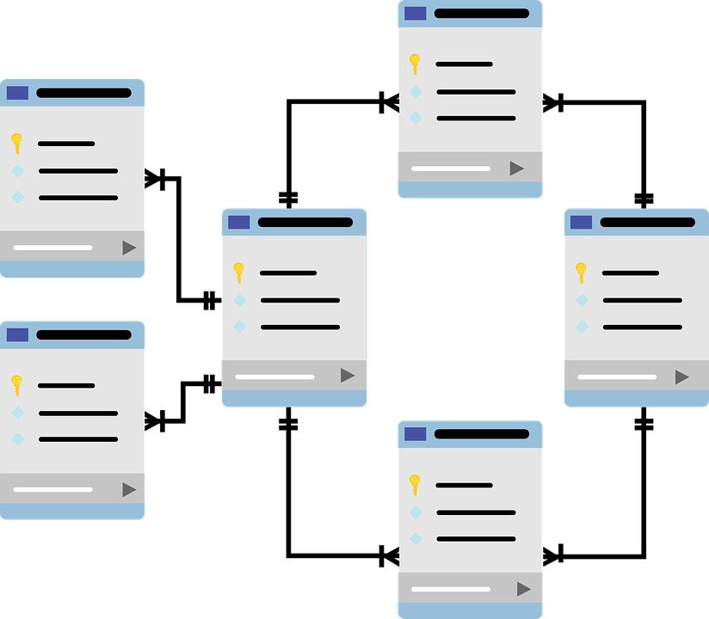
Relational Database
A relational database data in a collection of tables that are connected to each other. Each table corresponds to a real-world object.

Slide 16
DBMS Functions
Data dictionary management
  Data dictionary: stores definitions of data elements and their relationships
Data storage management
  Performance tuning ensures efficient performance
Data transformation and presentation
  Data is formatted to conform to logical expectations
Security management
  Enforces user security and data privacy

Slide 17
DBMS Functions
Multiuser access control
  Sophisticated algorithms ensure that multiple users can access the database concurrently without compromising its integrity
Backup and recovery management
  Enables recovery of the database after a failure
Data integrity management
  Minimizes redundancy and maximizes consistency

Slide 18
SQL Server
SQL stands for
Structured Query Language.
SQL is a special-purpose programming language designed to handle data in a relational database management system.
A database server is a computer program that provides database services to other programs or computers, as defined by the client-server model. Therefore, a SQL Server is a database server that implements the Structured Query Language (SQL).

Slide 19
Preparing for Your Database Professional Career
TABLE 1.3 | DATABASE CAREER OPPORTUNITIES
JOB TITLE | DESCRIPTION | SAMPLE SKILLS REQUIRED
Database Developer | Create and maintain database-based applications | Programming, database fundamentals, SQL
Database Designer | Design and maintain databases | Systems design, database design, SQL
Database Administrator | Manage and maintain DBMS and databases | Database fundamentals, SQL, vendor courses
Database Analyst | Develop databases for decision support reporting | QL, query optimization, data warehouses
Database Architect | Design and implementation of database environments (conceptual, logical, and physical) | DBMS fundamentals, data modeling, SQL, hardware knowledge, etc.
Database Consultant | Help companies leverage database technologies to improve business processes and achieve specific goals | Database fundamentals, data modeling, database design, SQL, DBMS, hardware, vendor-specific technologies, etc.
Database Security Officer | Implement security policies for data administration | DBMS fundamentals, database administration, SQL, data security technologies, etc.
Cloud Computing Data Architect | Design and implement the infrastructure for next-generation cloud database systems | Internet technologies, cloud storage technologies, data security, performance tuning, large databases, etc.
Data Scientist | Analyze large amounts of varied data to generate insights, relationships, and predictable behaviors | Data analysis, statistics, advanced mathematics, SQL, programming, data mining, machine learning, data visualization

Slide 20
Exercise 1
How many records does the file contain? How many fields are there per record?
If you wanted to produce a listing of the file contents by last name, area code, city, state, or zip code, how would you alter the file structure?
What data redundancies do you detect? How could those redundancies lead to anomalies?

Slide 21
Exercise 2
Identify and discuss the serious data redundancy problems exhibited by the file structure shown above.
Identify the various data sources in the file.
What changes do you recommend to eliminate the data redundancies from the above database structure.

